Slide 1
IBAMR Lecture 8 - Adding mass to the boundaries

Slide 2
.vertex, .spring, .beam, .mass files
In addition to the input2d/input3d files, there are a number of files that specify the initial conditions and material properties of the immersed elastic structures.
The only such file that is required is the ".vertex" file, which specifies the initial positions of the IB points.
There are several additional files that may be optionally specified:
A ".spring" file can be used to specify an essentially arbitrary network of linear or nonlinear springs that connect the various IB points. Each "spring" connects precisely two IB points.
A ".beam" file can be used to specify a collection of linear beams with a preferred curvature. Each "beam" connects precisely three IB points.
A ".target" file is used to specify IB points that are, by default, "tethered" by stiff linear springs to their initial positions.
A ".mass" file is used to specify any additional mass associated with the IB points. For such files to have any effect, it is necessary that the IB solver be run in "penalty-IB" mode.
Notes:
*

Slide 3
Mass point file format
Mass point input files end with the extension ".mass" and have the following format:
M # number of mass points in the file
i_0 mass_0 kappa_0 # vertex index, point mass, penalty spring constant
i_1 mass_1 kappa_1
i_2 mass_2 kappa_2
...
Note:
Mass points are anchored to "ghost" massive particles by linear springs with the specified spring constants and with zero resting lengths. The massive particles are "isolated" and simply move according to Newton's laws. The penalty parameter provides control over the energetic penalty imposed when the position of the Lagrangian immersed boundary point deviates from that of its massive copy.

Slide 4
Point mass attached to a string
Look at example 8-AddingMass-Spider in the examples folder.
This examples uses the module ibamr/2018-03
In this example, a mass is attached to the bottom of a string.
The string resists bending (a little) and stretching and is massless.
This is a simplified model of spider ballooning.
The spider is represented as the point mass.
The silk drag line is the string (massless)
The spider falls to the bottom of the domain due to gravity. The dragline slows it down.

Slide 5
Spider ballooning example
d: silk diameter
Dragline
Massless
Resists stretching and bending
Body
Zero body diameter (body drag neglected)
Prescribed mass
Flow profile
Quiescent fluid
Uniform flow at angle 𝛳 to the horizontal
Lid driven flow
L: thread length
V = background flow velocity
𝛳: flow angle
m: mass
D: body diameter
Notes:
In all simulations, the model is constructed as a point mass at the end of a massless, elastic silk drag line.
We performed three types of simulations: free fall (settling), uniform background flow, and shear flow.

Slide 6
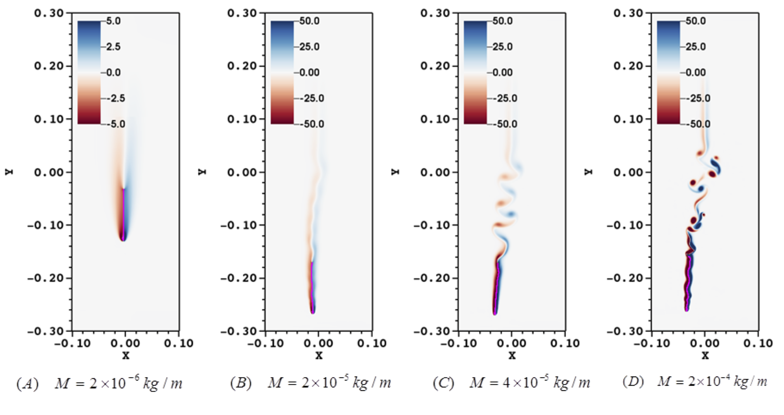
Vorticity plots for variations in Re

Slide 7
generate_mesh2d.m
This matlab file creates
the string made of vertices (.vertex file)
The springs that connect pairs of vertices (.spring file)
The beams that connect triads of vertices (.beam file)
The mass at the end of the string
Note that this is a 2d simulation. The mass is actual a mass per unit length.

Slide 8
Input2d
// physical parameters
W = 0.3 // Domain width, meters
H = 0.6 // Domain height, meters
MU = 0.00001846 // air viscosity
RHO = 1.177 // air density, kg/m^3
// grid spacing parameters
MAX_LEVELS = 3 // maximum no. levels in locally refined grid
REF_RATIO = 4 // refinement ratio between levels
N = 16

Slide 9
Input2d continued
IBStandardInitializer {
max_levels = MAX_LEVELS
structure_names = "spider2d_256"
spider2d_256 {
level_number = MAX_LEVELS - 1
} }
PenaltyIBMethod {
delta_fcn = DELTA_FUNCTION
enable_logging = ENABLE_LOGGING
gravitational_acceleration = 0.0,-9.8
}

Slide 10
Main.C
// Headers for application-specific algorithm/data structure objects
#include <ibamr/IBExplicitHierarchyIntegrator.h>
#include <ibamr/IBMethod.h>
#include <ibamr/IBStandardForceGen.h>
#include <ibamr/IBStandardInitializer.h>
#include <ibamr/INSCollocatedHierarchyIntegrator.h>
#include <ibamr/INSStaggeredHierarchyIntegrator.h>
#include <ibtk/AppInitializer.h>
#include <ibtk/LData.h>
#include <ibtk/LDataManager.h>
#include <ibtk/muParserCartGridFunction.h>
#include <ibtk/muParserRobinBcCoefs.h>
#include <ibamr/PenaltyIBMethod.h>

Slide 11
Main.C continued
// Create major algorithm and data objects that comprise the
// application. These objects are configured from the input database
// and, if this is a restarted run, from the restart database.
Pointer<INSHierarchyIntegrator> navier_stokes_integrator;
const string solver_type = app_initializer->getComponentDatabase("Main")->getStringWithDefault("solver_type", "STAGGERED");
Pointer<PenaltyIBMethod> ib_method_ops = new PenaltyIBMethod("PenaltyIBMethod", app_initializer->getComponentDatabase("PenaltyIBMethod"));

